Slide 1
HEART DISEASE
Cole Phillips
BigML Project
Notes:
-Heart disease can be silent and not diagnosed until a person experiences a heart attack, heart failure, or an arrhythmia. What if there was a way to accurately predict if someone has heart disease before any of these events occur?
-My name is Cole and this is my BigML software project on heart disease.

Slide 2
Heart Disease
Leading cause if death in the United States
About 659,000 people in the US die each year
805,000 people have a heart attack each year
Notes:
According to the CDC, heart disease is the leading cause of death for men and women in the United States. One person dies every 36 seconds from cardiovascular disease. About 659,000 people in the US die each year, and 805,000 people have a heart attack each year.
These numbers can be greatly reduced if there was an accurate and reliable way to predict whether someone has heart disease.

Slide 3

Heart Healthy Co.
Notes:
-Heart Healthy Co. is a company that is dedicated to the reduction of death and disability from cardiovascular diseases including heart diseases and stroke.

Slide 4

Predictive Software
1
Accurate heart disease predictions
2
Reduced death and disability probability
Notes:
- Heart Healthy Co. wants to develop a predictive software to sell to medical companies so they can incorporate the software into their patient database to accurately predict if patients are likely to have heart disease.
- By implementing their software, people can know if they have a heart condition before they have a heart attack, heart failure, or an arrhythmia.
- This software can potentially save people’s lives and inform them about their heart condition.

Slide 5
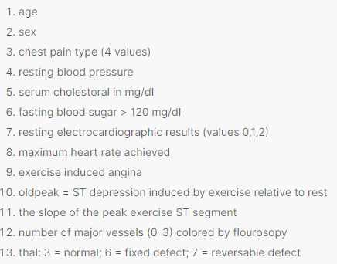

Data Source
Notes:
-The data source used was from Kaggle.com. The dataset is from the UCI Machine Learning Repository, and there are records of about 300 patients from Cleveland.
-The dataset contains 14 attributes that help determine whether a person has heart disease or not. There are 8 categorical and 6 numeric attributes.
-The attributes were age, sex, chest pain type, resting blood pressure, exercise induced angina, resting electrocardiographic results, and more

Slide 6

Data Preparation
Removal of incorrect data values
Turned some numerical values into categorical values
165 normal patients & 138 patients with heart disease
Notes:
Target (yes, they have heart disease or no, they don’t have heart disease) is the dependent variable in the dataset.
I removed some of the patients that had a thal attribute of 0 because that is an incorrect value.
Some of the attributes were numerical values when they should have been categorical values, so I changed them to categorical values to make the data easier to understand. The values I changed were sex, chest pain, fbs, resting electrocardiogram results, exercise angina, slope, and thal.
The data is almost split 50/50 with 165 patients not having heart disease and 138 patients having heart disease.

Slide 7
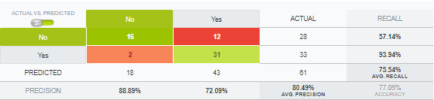
Evaluation Model
Notes:
-After prepping the data, I created a 1-click model of the dataset. I then split the data using 80% training and 20% testing. I created a model with the 80% training data and then evaluated with the 20% test data.
-The evaluation model said there was 88.89% precision, 77% accuracy, and 76% recall, which is good.

Slide 8
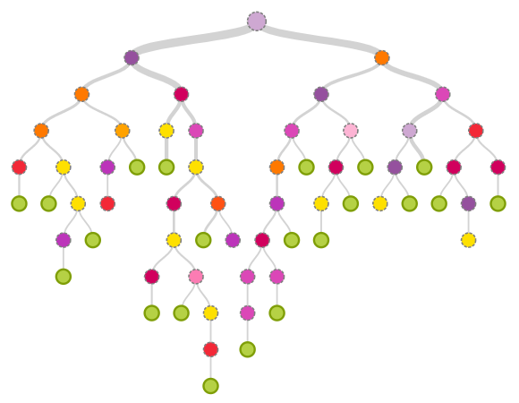
Decision Tree
Notes:
This decision tree shows the all the possible ways a heart disease prediction can be made based off the different attributes in the dataset.
Viewers can determine their likelihood of having heart disease by following the branches in the tree.

Slide 9
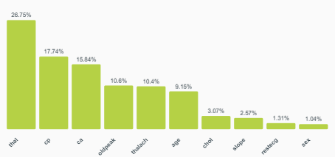
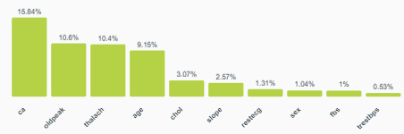
The Attributes
Most Attributes
Least Attributes
Notes:
We can see here that thal, cp, and ca are the top 3 most important attributes, and the least important attributes are sex, fbs, and trestbps.
Thal refers to the observed blood flow. The possible observations are no blood flow in parts of the heart, a normal flood flow, and a blood flow that is observed but not normal.
Ca refers to the number of main blood vessels. The higher value of this feature, the more likely it is to have a heart disease.
Cp refers to chest pain type. The possible values are asymptomatic, atypical angina, pain without relation to angina, and typical angina.
These attributes are most important to figuring out if a person has a heart disease, accounting for about 50% of the probability.
The least important attributes are account for a small portion of the probability, but they are important when combined with other attributes. For example, cholesterol may be high in some normal patients, it could be that these people weren’t fasting when the blood sample was taken.

Slide 10
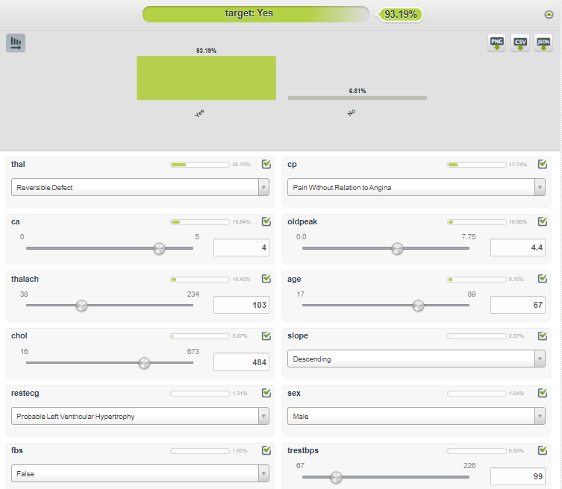
How can this model be used?
Notes:
This model can be used with patients to predict if they have a heart disease.
In this example, there is a man that is worried that he may heart condition after having consistent pain in his chest. After being checked by a doctor, the doctor enters the data in the software database, and the software says with about 93.19% confidence, the man has a heart disease.
By having this software available at doctors' fingertips, people will be able to figure out if they have a heart disease before it is too late to do something about it. This could have potentially saved this man’s life or saved his from dealing with disabilities from a heart attack.

Slide 11
Where to go from here
This software can accurately predict heart disease in men and women
As more patients come in, the data that is collected on them can be used to create an even more accurate model
The decision tree can be converted into software that medical professionals can use to enter data and get a prediction within seconds

Slide 12
What I’ve Learned
Through my analyses, I have learned that the chest pain type, type of blood flow, and number of blood vessels heavily influence if someone has a heart disease.
Although that sex, blood sugar level, and resting blood pressure weren’t the most reliable factors in determining a health disease diagnosis, they are still important when combined with the other factors.
It was interesting to see how much each risk factor accounted for heart disease probability. Since the information is real, it gave me a better understanding of heart disease.

Slide 13
Thank you!
Questions?

